Slide 1
SFA update
Nina Ketcher
Provider management team
February 2017

Slide 2
Apprenticeship levy provider readiness

Slide 3
Updated publications
Apprenticeship technical funding guidance
https://www.gov.uk/government/publications/apprenticeship-technical-funding-guide
Apprenticeship funding and performance management rules 2017 to 2018
https://www.gov.uk/government/publications/apprenticeship-funding-and-performance-management-rules-2017-to-2018
2017 to 2018 Individualised Learner Record (ILR) data
https://www.gov.uk/government/publications/ilr-specification-validation-rules-and-appendices-2017-to-2018

Slide 4
Provider readiness
Objective
‘Preparing existing and future training organisations for the changes brought about by the Apprenticeship Reform to enable them to respond to employer demand through both the levy and non-levy systems’.
Success Criteria
‘The SFA has funding agreements and contracts in place with a network of fully compliant apprenticeship providers; who are responsive in meeting the geographical and sectoral needs of all employers in a reformed apprenticeship system’.

Slide 5
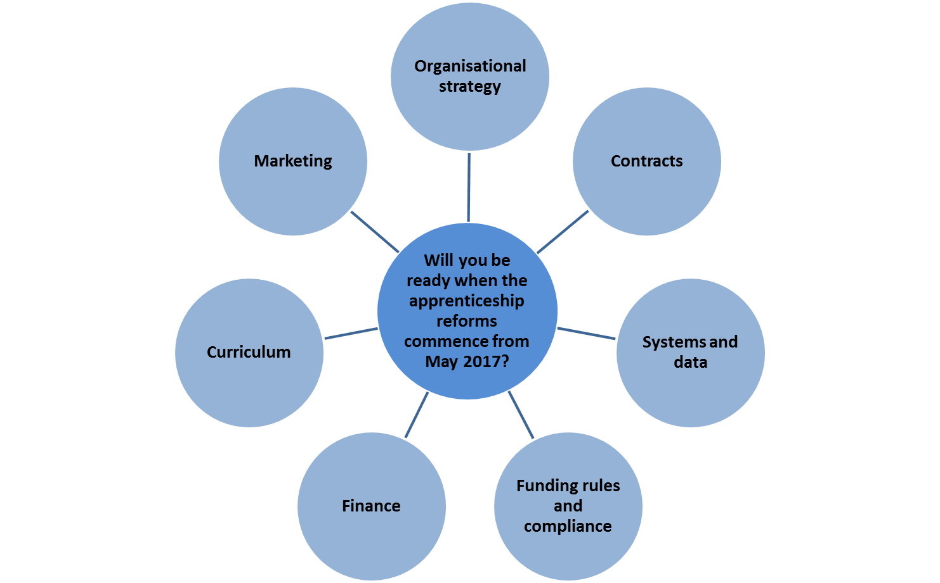
Apprenticeship levy and reforms – are you ready?

Slide 6
Provider readiness survey: outcomes
676 providers completed the full survey
14% believe they are fully ready for the reforms.
22% are not involved in trailblazer groups or do not know how to get involved, but 89% have developed or are developing a strategy to convert their offer to standards.
33% of providers expect income levels to reduce when the reforms are implemented, whilst 11% have not yet planned for variations in funding.
Only 8% of providers expect between 50% and 75% of delivery to come through levy paying employers,
26% of colleges have not yet reviewed sub contracting arrangements

Slide 7
How ready is Lancashire?
Thirteen providers completed the full survey
Four believe they more than half-way ready for the reforms
Most prepared areas: governance, employer engagement strategy includes standards, MIS
Least prepared areas: internal compliance, employer contributions, conversion of frameworks, marketing materials, SME understanding, potential funding/income variations, managing multiple funding systems

Slide 8
Support & challenge
Why
Ensure oversight of the sector’s response to the reforms
Provide assurance to DFE/ministers that the sector is readying itself for the reforms and that progress is measurable
Scrutinise risks concerning the readiness of colleges
Ensure the Future Apprenticeship programme reflects the needs of the sector and that the sector utilise the support available where needed

Slide 9
Support & challenge
Roles and responsibilities
SFA/EFA joint intervention team lead for all colleges in pre and formal intervention
Provider management team lead for all independent training providers, HEIs and any colleges not included above

Slide 10
Support & challenge
How
Contact providers to discuss the outcome of their online assessment tool
Agree with the provider those key business areas that require further development
Encourage use of the Future Apprenticeships toolkit:
http://futureapprenticeships.org.uk/
Maintain contact to monitor / report progress until the end of the support and challenge phase
Report on provider’s own judgement

Slide 11
What else is going on?

Slide 12
Mid-year funding claims 2016 to 2017
Deadline is Friday 10 February 2017 at 4pm
Submit through the Hub, use technical guidance if necessary
https://www.gov.uk/government/publications/sfa-funding-claims
Help and support through service desk:
Email: servicedesk@sfa.bis.gov.uk
Telephone: 0370 2670001
Service Desk opening hours:
8:30am to 5:00pm Monday to Thursday
8:30am to 4:00pm Friday
For providers funded through a grant | For providers funded through a contract
Adult education budget (AEB) Adult apprenticeships Advanced learner loans bursary funding | Discretionary learner support funding Community learning
For all applicable providers
Community learning mental health pilot

Slide 13
Adult education budget procurement
Now open. Closing date is 27 February 2017 at 5pm
Open to all eligible providers on Register of Training Organisations who:
passed capacity and capability for delivery of education and training services, and
expressed an interest in delivering relevant provision
See the narrated presentation on youtube (11 mins):
https://www.youtube.com/watch?v=5ZMvRRqNeDc
Any questions must be directed through the e-tendering portal

Slide 14
Recent updates for 2016 to 2017
Apprenticeship Grant for Employers (AGE) for January to April 2017
https://www.gov.uk/government/publications/apprenticeship-framework-funding-rules
Apprenticeships common funding and performance-management rules
https://www.gov.uk/government/publications/apprenticeships-common-funding-rules

Slide 15
Planning for 2017 to 2018
Draft AEB funding and performance-management rules
https://www.gov.uk/government/publications/adult-education-budget-funding-and-performance-management-rules-2017-to-2018
AEB funding rates and formula
https://www.gov.uk/government/publications/adult-education-budget-funding-rates-and-formula-2017-to-2018

