Slide 1
Apprenticeship Funding

Slide 2
Purchasing training
The new funding system comes into effect on 1 May 2017, because May is the first month that levy paying employers will declare a levy payment to HMRC. All apprenticeships started before 1 May will be funded through to completion according to the existing rules. Any employer contribution towards training commenced before 1 May will also continue at the current rate.
Levied employers buying training from May 2017
As soon as an employer has funds in their levy account they will be able to select a provider and an apprenticeship programme and commit to this. By committing to apprenticeship training via the digital account, the employer will be entering into a contract agreement with the provider.
Once committed to training, funds will automatically leave the employer’s digital account on a monthly basis, spread over the lifetime of the apprenticeship.
We propose to hold back 20% of the total cost, to be paid on completion of the apprenticeship.
Information and tools in the digital account will help employers forecast the funds that are likely to accumulate in their account over time and manage cash flow.
Non-levied employers buying training from May 2017
Employers that don’t pay the levy will make payments for training direct to providers. We will move them onto the digital system at a later date.

Slide 3
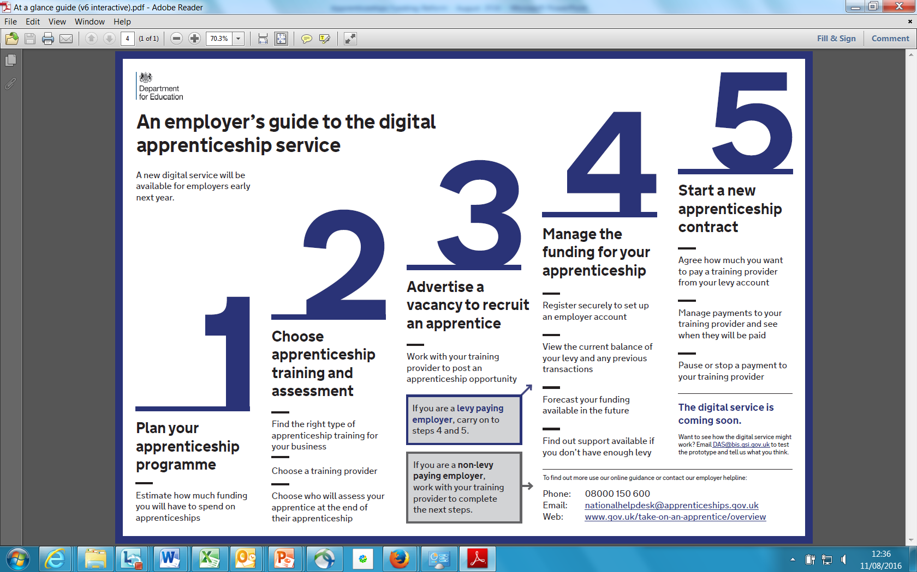
The Digital Apprenticeship Service
NOTE
Employers who don’t pay the levy will not need to use the digital apprenticeship service to pay for apprenticeship training and assessment until at least 2018. When we ask them to start using the digital apprenticeship service to pay for apprenticeship training, we will help them to prepare.

Slide 4
Provisional funding bands
Number | Band limit
1 | £1,500
2 | £2,000
3 | £2,500
4 | £3,000
5 | £3,500
6 | £4,000
7 | £5,000
8 | £6,000
9 | £9,000
10 | £12,000
11 | £15,000
12 | £18,000
13 | £21,000
14 | £24,000
15 | £27,000
Why? Setting limits on the amount of government or digital funds that can be used for a single apprenticeship supports quality training whilst ensuring apprenticeships are affordable for individual employers and deliver value for taxpayers.
Every apprenticeship will be placed in a funding band
All existing and new apprenticeship frameworks and standards will be placed within one of these funding bands. This will depend on the level and type of apprenticeship.
The upper limit of each funding band will cap the maximum amount of digital funds an employer who pays the levy can use towards an individual apprenticeship.
The upper limit of the funding band will also cap the maximum price that government will ‘co-invest’ towards, where an employer does not pay the levy or has insufficient digital funds and is eligible for extra support.
Employers can negotiate the best price for the training they require
Employers will be able to negotiate prices with providers.
If employers want to spend more than the funding band limit, using their own money, then they will be free to do that.
Funding bands do not have a lower limit.

Slide 5
Provisional funding bands for frameworks
Current system
Government funds apprenticeship frameworks at different rates depending on the age of the learner. In future we will be putting funding in the hands of employers and the system needs to be simple for them to navigate, choose the apprenticeship training they want to purchase and negotiate on price. That means we have to simplify some of the complex funding arrangements that currently exist, while retaining the right incentives for high quality training.
Proposals
We propose to allocate each individual framework pathway to a single funding band, regardless of the age of the learner, or geographic location. This will bring frameworks into line with the funding system for apprenticeship standards and dramatically simplify the experience of employers.
We propose to allocate individual framework pathways to the nearest funding band based on the current rate of funding the government pays providers for training adult apprentices.
For all STEM framework pathways we propose to increase the current government-funded adult rate by 40% at Level 2 and 80% at Level 3 and above, and then allocate these frameworks to the nearest funding band. This uplift takes into account the fact that employers of these apprentices are currently disproportionately likely to be paying extra to providers on top of the funding provided by government.
For this purpose, we propose to determine STEM frameworks by sector subject area. There are thirteen sector subject areas and we propose to apply the uplifts to: Engineering and Manufacturing Technologies; Information and Communication Technology; Science and Mathematics; and Construction, Planning and the Built Environment.
We invite feedback from employers and providers about this proposal, including how STEM should be defined.

Slide 6
Provisional funding bands for standards
Current system
Currently, standards are currently paid for through a combination of government and employer funding. The government pays two-thirds of the cost and employers are required to pay one-third, and the maximum total core funding for the most expensive standard in the highest funding band is £27,000.
Proposals
Apprenticeship standards are employer-designed and offer employers and apprentices a more robust and relevant training experience. This is recognised in the current funding system and we will recognise it in the new system by allocating higher funding bands to apprenticeship standards, relative to equivalent frameworks, where appropriate.
We propose that existing apprenticeship standards are allocated to new funding bands according to the following principles:
Lower cost standards should be allocated to the new funding band that most closely aligns with the current funding band the standard is assigned to. For example, all standards in the current band 2 (maximum of £4,500 total core funding) will be allocated to the proposed new band 5, which has an upper limit of £5,000.
Those standards currently assigned to the widest and highest cost funding band, which ranges from £12,000 to £27,000, will be allocated to a new band within this range. When identifying where individual standards should fit within this range we have taken into account:
Where there have been starts on standards and we have reliable data, the actual prices employers have negotiated with providers.
The evidence originally presented by Trailblazer employers on the estimated costs of training, and taking into account only those costs which are eligible for public funding according to the existing funding rules.
The funding bands set for equivalent frameworks, where comparisons exist.
The level and nature of the training, and consistency across similar types of apprenticeship standard.
We invite feedback from employers and providers on these proposals, which aim to support quality apprenticeship starts whilst ensuring value for money and that apprenticeships are accessible to employers of all sizes.

Slide 7
Co-Investment
There are two types of employers who will be benefit from government support towards the cost of their apprenticeships training:
Employers who haven’t paid the levy and want to purchase apprenticeship training from a provider
A levy-paying employer who with insufficient funds in their digital account to pay for the cost of training and assessment they want to purchase
We propose that:
The government pays 90% of the costs of training and assessment.
The employer will be responsible for paying 10% of the costs.

Slide 8
Need to format with headings
WITHIN THE FUNDING BAND LIMIT
OVER THE FUNDING BAND LIMIT
Funding limits– how they work
Example funding band limit = £6,000
Price you negotiate with your training provider = £5,000
The cost is within the funding band limit
Example funding band limit = £6,000
Price you negotiate with your training provider = £7,500
The cost is above the funding band limit
With enough funding in your account
Without enough funding in your account
With enough funding in your account
Without enough funding in your account
£5,000 will be deducted from your digital account over the life of the apprenticeship.
If you have £0 in your account we will pay 90% (£4,500) and you will need to pay 10% (£500).
If you have digital funds available, these will be used first, and then we will pay 90% of the remaining costs, and you will pay 10%.
£6,000 will be deducted from your digital account over the life of the apprenticeship.
You will be responsible for paying £1,500. This payment can’t be made from your digital account
If you have £0 in your account we will pay 90% (£5,400) and you will need to pay 10% (£600). This is the maximum payable within the limit of the band.
You will also be responsible for paying the additional £1,500. This payment can’t be made from your digital account

Slide 9
Additional support for apprentices
Funding for 16-18 year olds
Government proposes to pay £1,000 to employers, and a further £1,000 to training providers if they train a 16-18 year old apprentice.
We propose to help with the extra costs of supporting these individuals so that everyone has the opportunity to benefit from an apprenticeship. Employer funding will be paid through the training provider.
Disadvantaged young people
Government proposes to pay £1,000 to employers, and a further £1,000 to training providers if they train 19-24 year olds leaving care or who have a Local Authority Education and Healthcare plan.
We propose to help with the extra costs of supporting these individuals so that everyone has the opportunity to benefit from an apprenticeship. Employer funding will be paid through the training provider.
Funding for additional learning support
This is the extra amount that we propose to pay to the training provider where an apprentice requires additional learning support as a result of conditions such as dyslexia, learning difficulties or disabilities. We propose to pay training providers up to £150 a month to support these learners, plus additional costs based on evidenced need. This is a continuation of the current system.
Funding for English and Maths training
The government is committed to helping apprentices gain the minimum standard of Level 2 in English and maths.
When employers agree with their training provider that their apprentice needs training to meet the minimum standards in English and maths we propose to pay training providers £471 for each of these qualifications (Level 1 and 2).
This will come direct from the government and will not be deducted from an employer’s digital account.

Slide 10
Funding rules
Transferring funding
During 2018, subject to a final value for money assessment, we propose to introduce means for employers to transfer up to 10% of the levy funds entering their digital account in a given year, to another employer with a digital account, or to an ATA.
We will assess the impact and effectiveness of these arrangements before considering how they could be expanded.
Prior qualifications
Employers will be able to use funds in their account or access government co-investment support to train any individual to undertake an apprenticeship at a higher level than a qualification they already hold.
In addition, we propose that an individual can be funded to undertake an apprenticeship at the same or lower level than a qualification they already hold, if the apprenticeship will allow the individual to acquire substantive new skills and the content of the training is materially different from any prior training or a previous apprenticeship.
Cross-border funding
The current apprenticeship funding rules place conditions on which individuals can be funded to undertake an apprenticeship through the English system. We propose to simplify the current rules and apply a single test for whether apprenticeship training can be funded through the English system: whether the apprentice’s main place of employment is England.
We propose that the definition of workplace is the physical place of work, designated by the employer, where the apprentice is expected to spend the majority of their time during their apprenticeship. We welcome feedback from employers on whether this is an appropriate test to apply to eligibility for funding.
We are continuing to engage with the Devolved Administrations on the scope for reciprocal funding arrangements for employees who live in England but who may work elsewhere in the UK.

Slide 12
Devolved Administrations
If you’re an employer with operations in Scotland, Wales or Northern Ireland, you may also want to contact their apprenticeship authority
Scotland
https://www.apprenticeships.scot/
Wales
https://businesswales.gov.wales/skillsgateway/apprenticeships
Northern Ireland
https://www.nidirect.gov.uk/campaigns/apprenticeships

